Slide 1
NM State 4-H Project Green Tops
Tamara Schubert
Chaves Co FCS/4-H Agent
tamschub@nmsu.edu

Slide 2
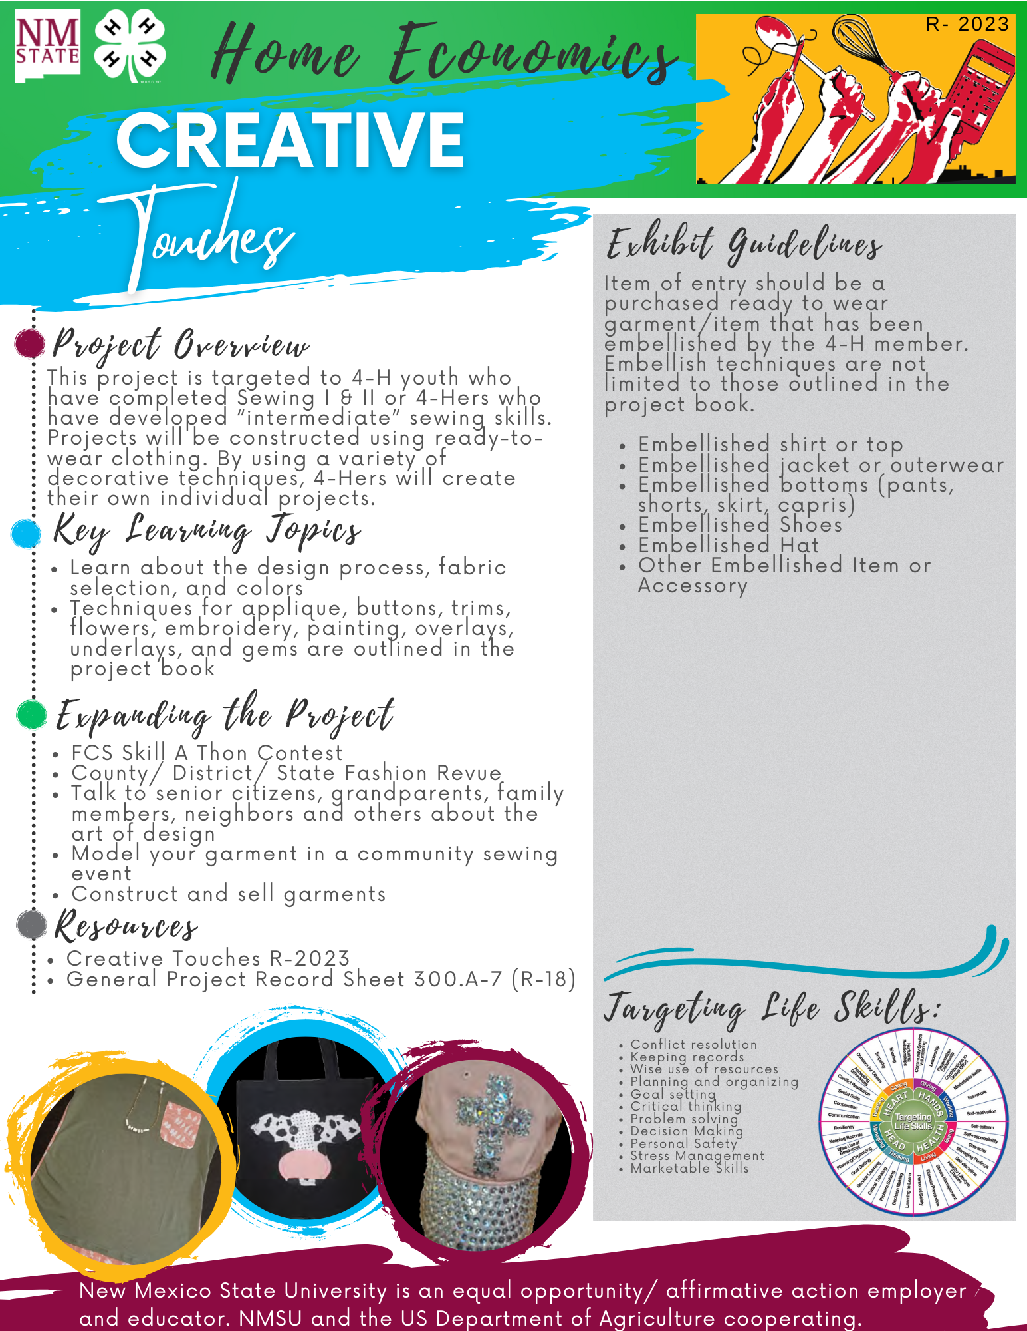
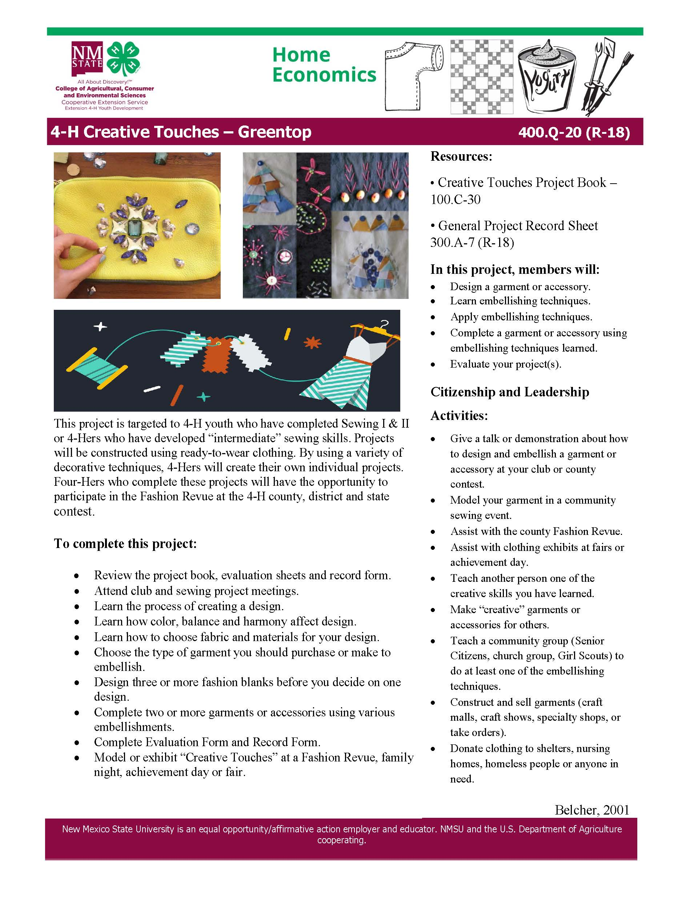
What are Project Green Tops?
Green Tops are 1 page project reference guides that provide information for members on any given project.
New
OLD
Tamara Schubert
Chaves Co FCS/4-H Agent
tamschub@nmsu.edu

Slide 3
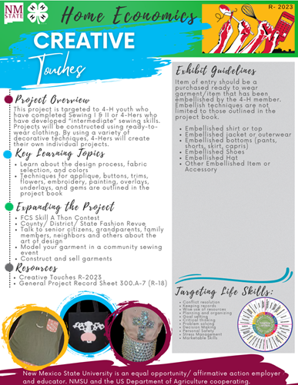
What’s on Project Green Tops?
Project Overview:
Quick description of what the project is about and who it is geared towards to aid members in choosing projects of interest.
Tamara Schubert
Chaves Co FCS/4-H Agent
tamschub@nmsu.edu

Slide 4
What’s on Project Green Tops?
Key Learning Topics:
Key points members can expect to learn throughout the project.
Tamara Schubert
Chaves Co FCS/4-H Agent
tamschub@nmsu.edu

Slide 5
What’s on Project Green Tops?
Expanding the Project:
What else can members do that relate to the project. Anything from community service to contests
Tamara Schubert
Chaves Co FCS/4-H Agent
tamschub@nmsu.edu

Slide 6
What’s on Project Green Tops?
Resources:
Lists appropriate Record Sheets and other corresponding projects in the series members may wish to take
Tamara Schubert
Chaves Co FCS/4-H Agent
tamschub@nmsu.edu

Slide 7
What’s on Project Green Tops?
Pictures:
Real pictures of projects within the curriculum or possible exhibits made by youth.
Tamara Schubert
Chaves Co FCS/4-H Agent
tamschub@nmsu.edu

Slide 8
What’s on Project Green Tops?
Exhibit Guidelines:
Quick reference of the classes which members can enter in fair with guidelines.
Tamara Schubert
Chaves Co FCS/4-H Agent
tamschub@nmsu.edu

Slide 9
What’s on Project Green Tops?
Targeting Life Skills:
What are members truly getting from this project that can be applied to life.
Tamara Schubert
Chaves Co FCS/4-H Agent
tamschub@nmsu.edu

Slide 10
Where can I find them?
https://4hprojects.nmsu.edu/
Tamara Schubert
Chaves Co FCS/4-H Agent
tamschub@nmsu.edu

